Slide 1
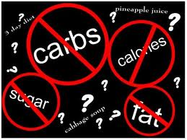
If it sounds too good to be true… is it?
Fad Diets

Slide 2
Using your i-Clicker to answer the following question:
Do you know someone who is trying to lose weight?
(This may even be you.)
A YES
B NO

Slide 3
Using your i-Clicker to answer the following question:
Do you know someone who is using a
special diet, has bought a diet book,
or is eating different foods?
A. YES
B. NO
C. I know someone on a diet, but am not sure what they are doing.

Slide 4
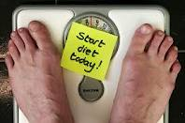
1st things first…
Does being on a diet mean you have to be cutting calories or making some type of nutritional limitation?
(example, low-fat, low-carb)
Yes
No

Slide 5
Diet:
anything a person consumes
includes food, drink, snacks

Slide 6
Teens in the USA
Teen obesity has tripled in the last 20 years!
Obese teens are more likely to have:
risk factors for cardiovascular disease
bone and joint problems
sleep apnea
social problems
poor self-esteem
Teens are replacing physical activity with 2 or more hours of TV everyday!
Notes:
Setting over 20% right now.
Cardiovascular disease included: high cholesterol and high blood pressure.

Slide 7
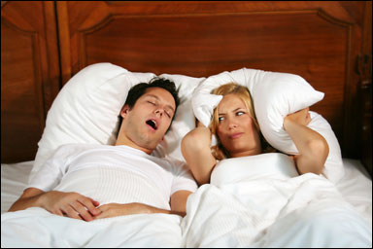
Long-Term Risk Factors
Heart disease
Cancer
Infertility
Varicose veins
Stroke
Snoring and sleep difficulties
Kidney stones
Gout
Diabetes
Over 50% of adults are overweight
Notes:
Cancer: colon, breast, endometrial, pancreas, prostate, uterine, cervial

Slide 8
The US spends 40 billion dollars a year on weight loss…
Diet books
Diet
Pills
Programs
Weight Loss
Gimmicks
1 billion dollars x 40
Shouldn’t someone be losing weight?

Slide 9
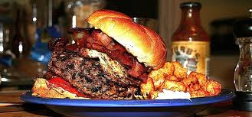
Why are so many failing?
Diet:
Larger portions
Foods that are high in calories, but low in nutrients
Food quality
Fewer fruits and vegetables
Food more readily available
Notes:
1.Restaurant servings, larger dinner plates at home, desserts with every meal.
2. Empty calories like soda, fruit juices
3. Fruits and veggies are picked before they are ripe, reducing their vitamin and mineral content
4. Food is available everywhere: resturants, vending machines, prepackaged “lite” snacks.

Slide 10
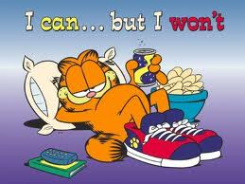
Why are so many failing?
Exercise:
People are moving less

Slide 11
Common Weight Loss Methods
Why are so many failing?

Slide 12
What is a fad diet?
Notes:
Give students time to answer, discuss possible answers

Slide 13
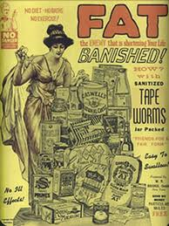
Fad diets offer
A short-term,
quick-fix approach
to weight loss that puts the dieter at risk
What are yo-yo dieters? Are they more vulnerable to fad diets and
product claims?
Notes:
These risks included: heart attack, dizziness, stomach problems.
Yo-yo dieters: people that repeatedly go on diets, lose weight, go off the diet, and then gain weight – often end up being able to store fat easier and therefore put on weight easier. Yo-yo dieting can also lead to health problems and make it harder to gain weight.

Slide 14
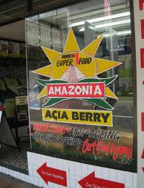
…but is this a FAD diet?
Red Flag Claims
Rapid weight loss
Sounds too good to be true
Rigid menus
No need to exercise
Magic foods or supplements
Bizarre quantities and limitations
Specific food combinations

Slide 15
Show Time!
Red Flag Activity:
You will be divided into groups.
Each group will be given 7 red flags.
I will read a diet description and as soon as your group hears your “red flag”, hold up the flag.
I will answer any questions about each situation before we move on.
Notes:
Divide students up as you feel necessary. You can also amend the directions to be per student. You can laminate cards and/or attach popsicles or sticks to make them like true flags or signs.

Slide 16
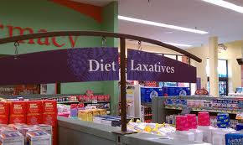
Red Flag Activity
Are any of these
situations fad diets?

Slide 17
Dig between the lines…
http://faddietsdecoded.weebly.com
Use the website shown above to complete
the Fad Diets Decoded Worksheet.
Be prepared to discuss your findings with the class.
Notes:
This assignment may be modified to be individual, partner, or group. You can remove the presentation element if necessary.

